Slide 1
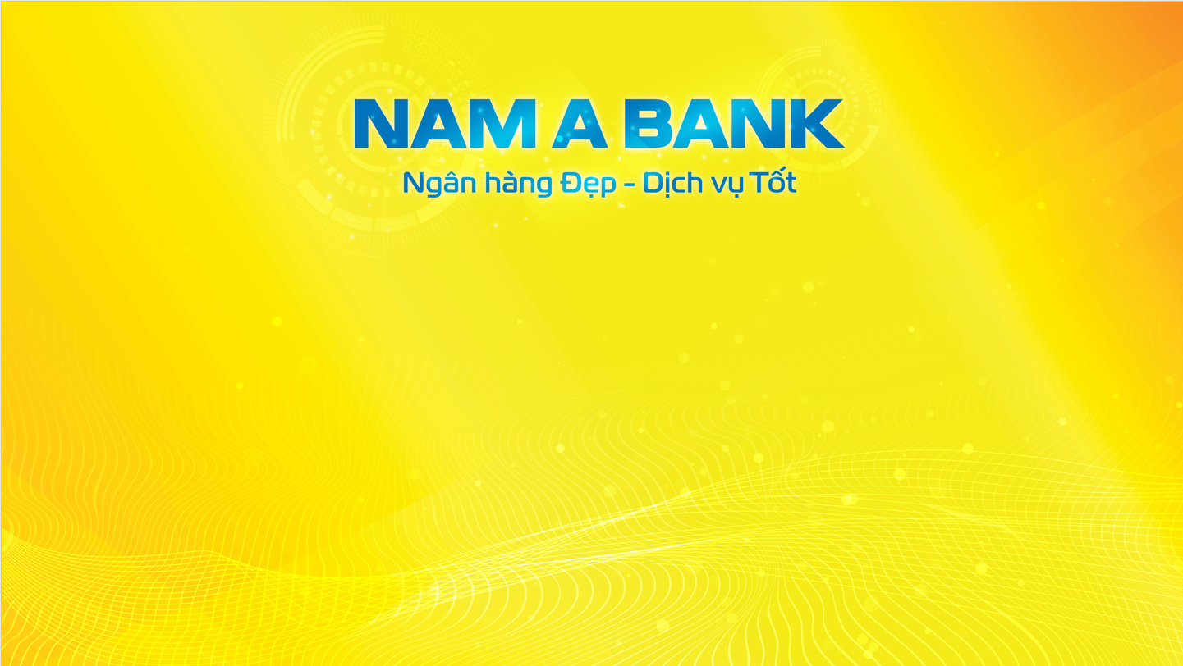
BIG DATA: The Fire of 21st century?
Mai Chí Bảo
Application Development Department – 18/3/2023

Slide 2
01. WHAT IS BIG DATA?

Slide 3
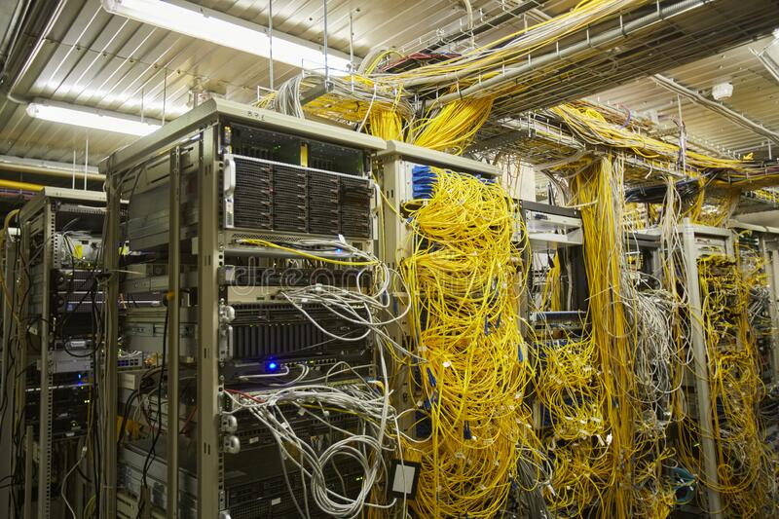
Large/ Complex data set
CAN’T be handled by Traditional Technology

Slide 4
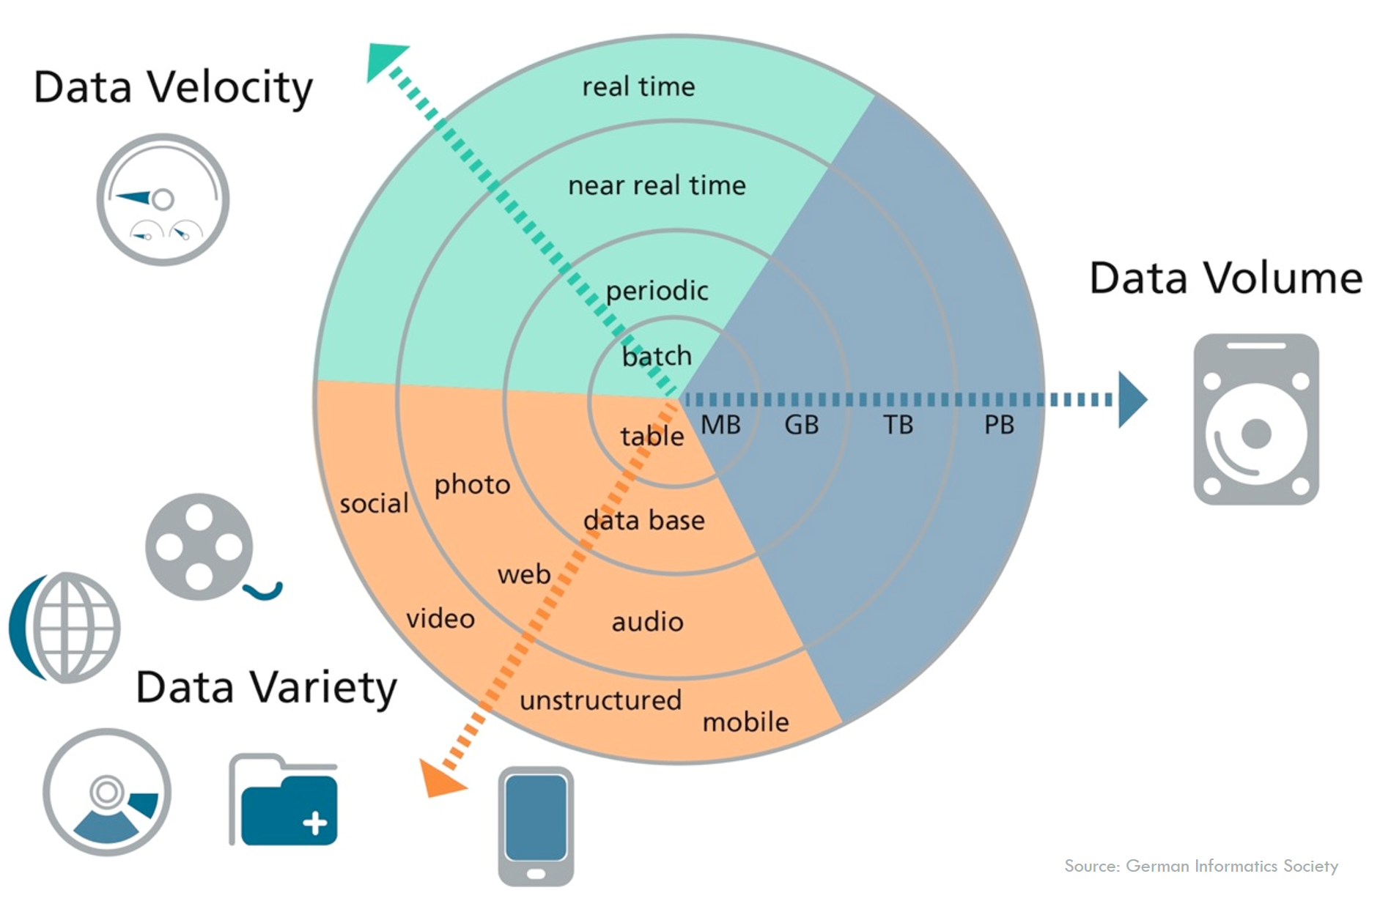
CHARACTERISTICS: 3 V’s of “BIG”Data
Notes:
Volume: This is the most typical characteristic of big data, the volume of data is very large. The size of Big data is increasing day by day, and as of 2012 it can range from a few tens of terabytes to many petabytes (1 petabyte = 1024 terabytes) for just one set of data. Velocity: can be understood in two aspects: (a) The volume of data is growing very fast (every second there are 72.9 million search requests on Amazon's sales web); (b) Fast data processing at the real-time level, which means data is processed immediately as soon as they arise (in milliseconds) Variety: For the traditional data we often talk about structured data, today more than 80% of the data generated is unstructured (documents, blogs, images, videos, songs, data from devices). physical sensors, healthcare devices, etc.). Big data allows linking and analyzing many different types of data. For example, with the comments of a certain user group on Facebook with video information shared from Youtube and Twitter

Slide 5
02. APPLICATIONS

Slide 6
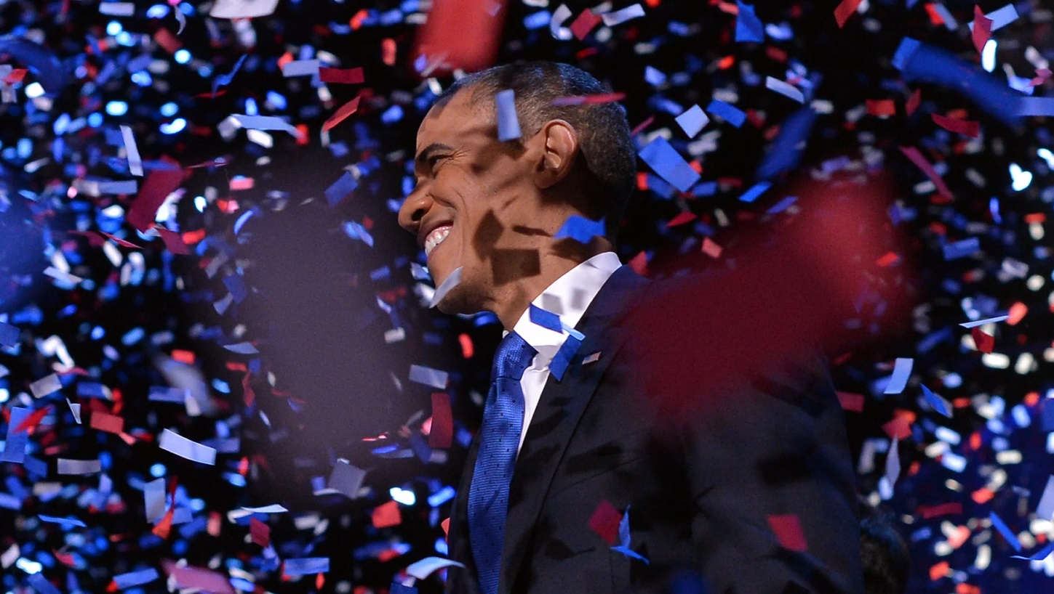
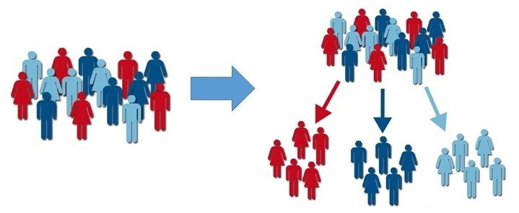
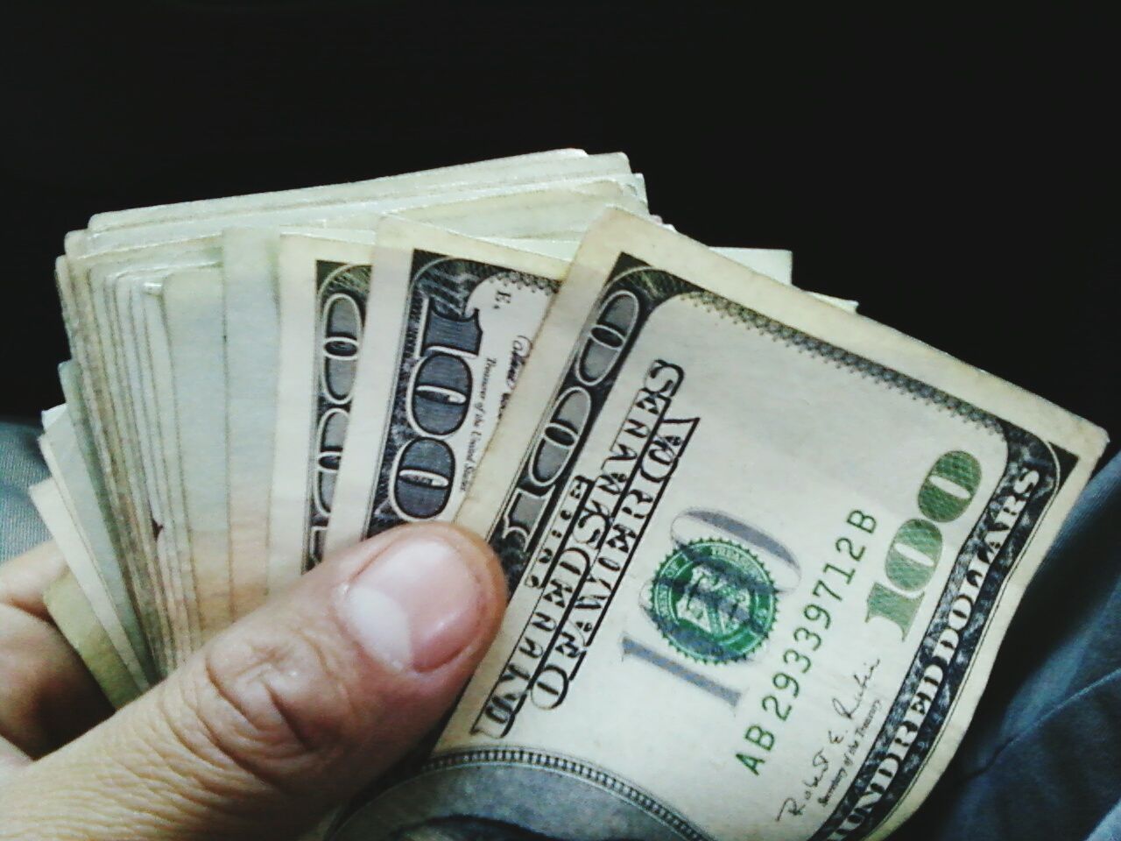

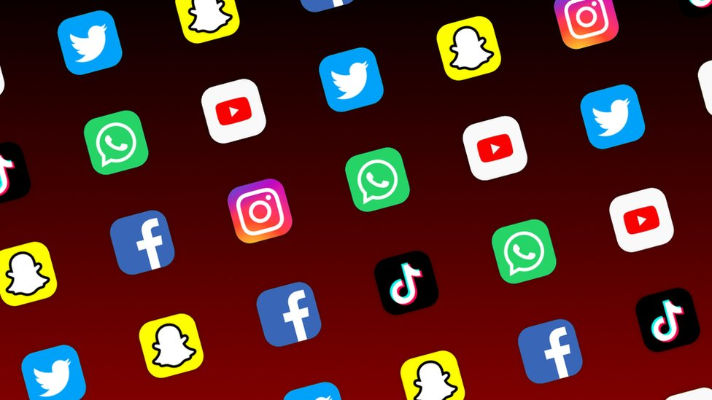
POLITICS:
Obama’s WINNING recipe?
Targeted outreach
Voter turnout
Fundraising
Social media
Notes:
Targeted outreach: The campaign used data from various sources, such as voter files, consumer data, and social media data, to identify potential supporters and tailor their messaging and outreach strategies. This included microtargeting ads to specific demographic groups and using data analytics to identify swing voters in key states.
Fundraising: The campaign used data-driven approaches to identify potential donors and personalize fundraising appeals. For example, the campaign used email marketing campaigns that targeted specific groups of supporters based on their interests and past donation history.
Voter turnout: The campaign used data analytics to identify likely voters and develop strategies to mobilize them to the polls. This included using predictive models to identify likely supporters and volunteers, and targeting get-out-the-vote efforts in key precincts.
Social media: The campaign was one of the first to use social media as a key tool for voter outreach and engagement. The campaign used data analytics to track social media activity and identify potential supporters, and used social media platforms to mobilize supporters and amplify their message.
Overall, the Obama campaign's use of Big Data was instrumental in their success, allowing them to identify and engage potential supporters, raise funds, and mobilize voters. The campaign's data-driven approach has been widely studied and emulated by political campaigns around the world.

Slide 7
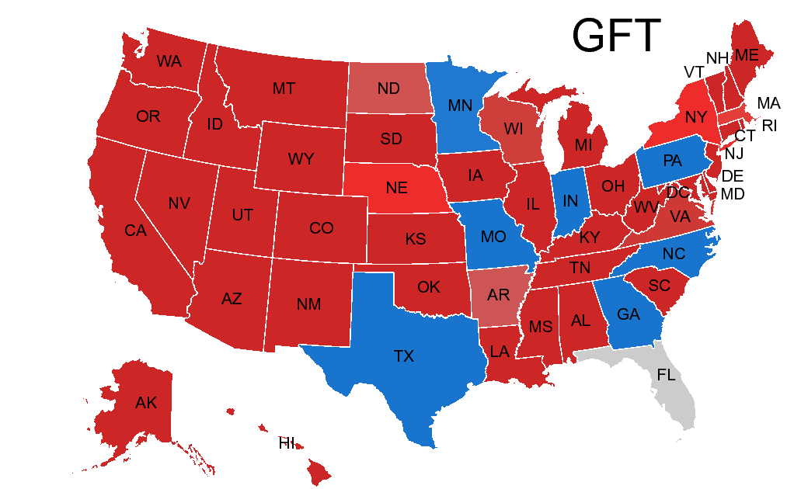
HEALTH CARE: Google Flu Trends
Patients search Google for “flu symptoms” before calling their doctors
The C.D.C. reports rely on data collected and compiled from thousands of health care providers, labs… => Slower
GFT avoids privacy pitfalls by relying only on aggregated data that cannot be traced to individual searchers.
Notes:
a lot of ailing Americans enter phrases like “flu symptoms” into Google search engines before calling their doctors
The C.D.C. reports are slower because they rely on data collected and compiled from thousands of health care providers, labs and other sources
Google Flu Trends avoids privacy pitfalls by relying only on aggregated data that cannot be traced to individual searchers.

Slide 8
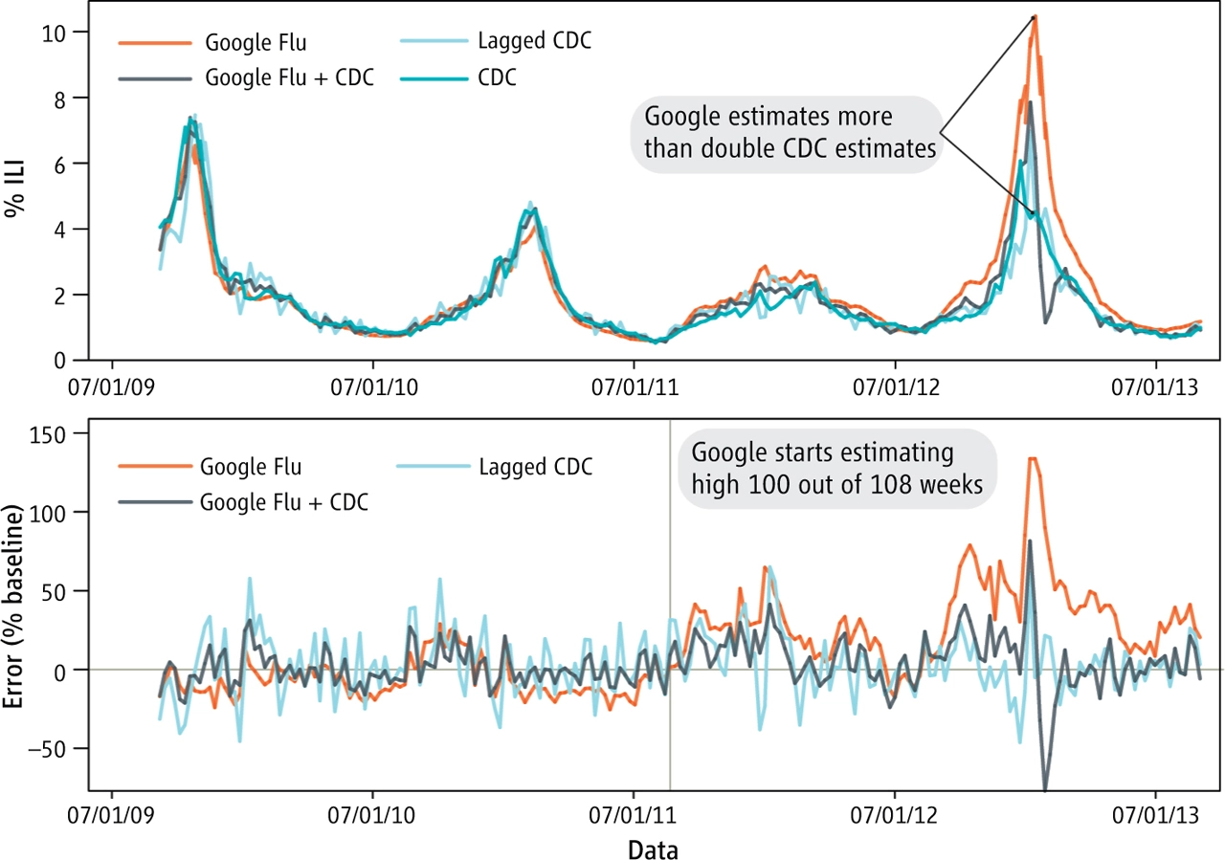
HEALTH CARE: Google Flu Trends
Being overly reliant on search data
Sometimes generating inaccurate estimates of flu activity levels.
Notes:
However, the project was also criticized for being overly reliant on search data and for sometimes generating inaccurate estimates of flu activity levels.
In 2015, Google announced that it was retiring the project and replacing it with a new system

Slide 9
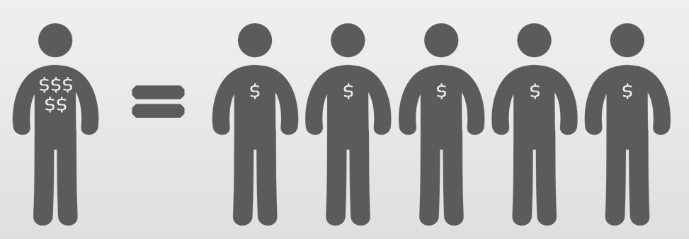
FINANCE: Customer Experience
Problems
Annual churn rate of 10-15%
Cost >> Revenue
Solutions
Focus on “High risk” customers
Based on Branch visit, Purchase history, Transaction Frequency
Did you know: Attracting a new customer costs 5X as much as keeping an existing one?
=> Save time, effort and MONEY
Notes:
The finance business has an annual churn rate of 10-15 percent in this highly competitive market.
customer retention is tough because most firms have a large number of customers and can't afford to devote much time to each of them. The costs would be too great, outweighing the additional revenue
it could focus customer retention efforts only on these "high risk" clients
To detect early signs of potential churn, one must first develop a holistic view of the customers and their interactions across numerous channels, including store/branch visits, product purchase histories, customer service calls, Web-based transactions, and social media interactions, to mention a few.

Slide 10
03. CHALLENGES & SOLUTIONS

Slide 11
BIG DATA Challenges
Data Breach
The loss or theft of sensitive information
Lead to financial loss and reputational damage.
03
Bias and Discrimination
Perpetuate or amplify biases and discrimination
Negative impacts on specific individuals or groups
01
02
Privacy Violations
Collecting and analyzing lots of personal data
Comply with the laws
Obtain appropriate consent from users
Notes:
Data breaches: Large amounts of data can make companies vulnerable to data breaches, which can result in the loss or theft of sensitive information, such as personal identification data or financial information. This can lead to financial loss and reputational damage.
Privacy violations: Big Data analytics can involve collecting and analyzing large amounts of personal data, which can raise concerns around privacy violations. Companies need to ensure that they are complying with relevant data privacy laws and regulations, and that they are obtaining appropriate consent from individuals before collecting and using their data.
Bias and discrimination: Big Data analytics can sometimes perpetuate or amplify biases and discrimination, particularly if the data being used is biased or incomplete. This can have negative impacts on individuals or groups that are already marginalized or discriminated against.

Slide 12
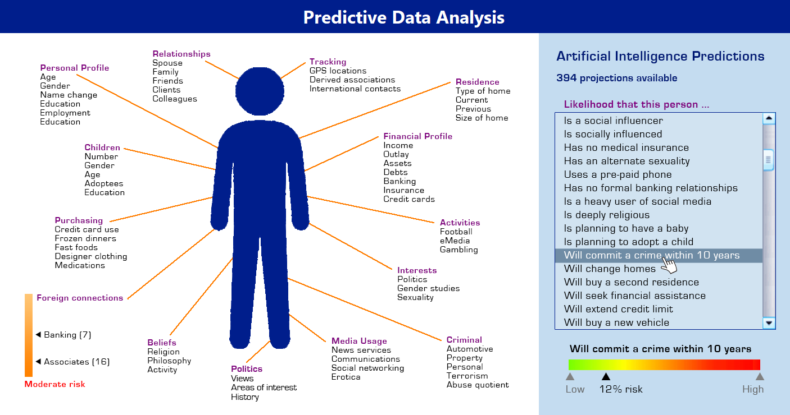

Slide 13
Solutions:
Privacy policies and regulations
Big companies adhere to privacy policies and government laws
Security measures
Apply firewalls, intrusion detection systems, and access controls
User consent and transparency
Provide options for users to control their privacy settings, and clear information about the data collection practices
Data Anonymization
Anonymize data by removing identifying information such as names, addresses, and social security numbers
Data encryption
Encoding data in a way that makes it unreadable without the proper decryption key
Notes:
Privacy policies and regulations: Big companies adhere to privacy policies and regulations to ensure they are handling user data in compliance with applicable laws and regulations
Security measures: Big companies implement various security measures to protect user data, such as firewalls, intrusion detection systems, and access controls. They also conduct regular security audits and implement best practices to prevent data breaches and protect against cyber attacks.
User consent and transparency: Big companies often provide clear information about their data collection practices and obtain users' consent before collecting and using their personal information. They also provide options for users to control their privacy settings and opt-out of data collection.
Data anonymization: To further protect users' privacy, companies may anonymize data by removing identifying information such as names, addresses, and social security numbers. This allows companies to analyze data while protecting the privacy of their users. (In most cases we don’t need these features for prediction, however it might amplify the bias and discrimination)
Data encryption: Big companies use data encryption to protect users' personal information from unauthorized access. This involves encoding data in a way that makes it unreadable without the proper decryption key. (like GFT using the aggregated data)

Slide 14
04. CONCLUSION

Slide 15


Volume: 45 TB of text
1 Book $≈$ 100,000 words => 45 TB of text $≈$ 4.5 million books.
AVG speed 200 words/min
=> 4,291 years!
Notes:
Volume: The volume of data used to train ChatGPT is massive. It was trained on a vast corpus of text data, including books, articles, and websites, consisting of billions of words. This large volume of data allows ChatGPT to generate responses to a wide variety of questions and topics.
Specifically, I was trained on the massive corpus of text data consisting of over 45 terabytes of text
To give you an idea of the scale of 45 terabytes of text, consider the following:
45 terabytes is equivalent to 45,000 gigabytes, or 45 million megabytes.
If we assume that the average length of a book is around 100,000 words, 45 terabytes of text would contain approximately 450 billion words.
To read all of this text at an average reading speed of 200 words per minute, it would take over 2.25 billion minutes, or approximately 4,291 years!
Velocity: The velocity of data refers to the speed at which data is generated, processed, and analyzed. In the case of ChatGPT, the velocity of data is relatively low, as the training data was processed and analyzed over a longer period. However, once trained, ChatGPT is capable of processing and responding to queries at a very high speed, with response times measured in milliseconds.
Variety: The variety of data refers to the different types and formats of data that are used. The training data used to train ChatGPT was sourced from a variety of different types of documents, including books, articles, and websites, and encompassed a wide range of topics and writing styles. This variety of data allowed ChatGPT to develop a deep understanding of language and context, enabling it to generate responses that are natural-sounding and contextually appropriate.

Slide 16
Volume: 45 TB of text
Variety: books, articles, and websites…
Velocity: milliseconds
Notes:
Chat GPT has created questions about changes.

Slide 17
Is BIG DATA the Fire of 21st century?
Notes:
Fire was created thousand years ago It cause trouble, kill people, yet it Lead to many invention For me Big Data is the new chapter if we try to figure out how to handle it So what is your opinion. I’ll leave the question for u.

Slide 18



